Slide 1

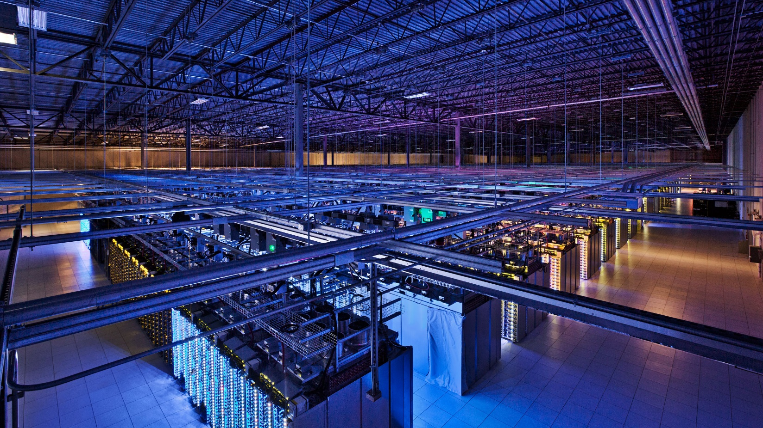
Database Final Presentation
Andrew, Alex, and Kathleen

Slide 2
Description of Application
how each aspect of your application will satisfy their needs
screen shots

Slide 3
UML Diagram
The Menu and Concessions schema were merged in our final database to reduce redundancy.
Also The Calendar is part of the Schedule schema so that it made the database easier to access for dates and times.

Slide 4


Required Queries
Focused on retrieving data for the user based on the field that the data is classified in.
For Example: Retrieve all of the data for concessions that the inventory is below a certain range.

Slide 5
Discussion of code snippets using embedded SQL

Slide 6
Project Application Demo
Our project is made in C#
It is a Windows Forms application.
Our program uses a 3 panel approach to display data to the user.
We can access each panel through separate functions that load data from the database.

Slide 7


Post-mortem
What went right?
What could have been done better?
As far as what went right, we did get the database to work with out application, as well as, we did create a working application that executes the processes needed to run a movie theater.
We did have a little bit of trouble with Github and merging data to be committed, but that is more of a side issue.
We also did simplify our original idea quite a bit. We definitely could have optimized and tested our code much more thoroughly throughout the entire development process.

Slide 8
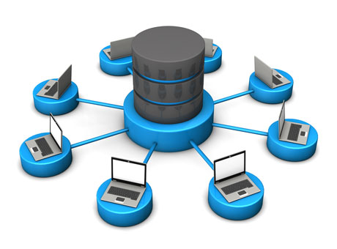
Class Concepts
Applied
Not Applied
Connecting a database to an application
SQL Server database storage
Relational model for a database system
No SQL concepts
Memory management techniques
Normalization (to a degree)

